Slide 1
Delegation, Inheritance versus parameterized types
Braeden, Jake, and Michael

Slide 2

Inheritance versus Parameterization
Parameterized types, also known as generics and templates are useful for reusing functionality.
This is useful when declaring a type without specifying the rest of the types that it uses.
An example, when you declare a list of objects but don’t define what value type is going to be passed to it you can define a generic value.
Inheritance lets your provide default implementations for operations and lets subclasses override them.
Parameterized types let you change the types that a class can use.
Implementation of parameterization purely depends on your design and implementation constraints.

Slide 3
Inheritance

Slide 4
What is inheritance?
Inheritance allows for the creation of new classes from an existing class.
The new class takes the properties and behaviour of the existing class.
Using inheritance allows for reusability.
Allows for functions to be extended.
Properties and behaviour of a class can be changed without affecting the main class.
Allows for less coding mistakes to occur as the same code won’t be typed multiple times.
New classes should use the same functions as the existing class (i.e. Fruit Class, which Banana and Apple inherits from).

Slide 5
Disadvantages of Inheritance
The existing and new classes are “tightly coupled” meaning they rely on each other and therefore, one cannot be used without the other.
The functions within the existing class must be used in the new class. Because of this, the super class of the subclass may need to be altered to deal with the new functionality within the system.
If a change in the function name is required, it will affect all subclasses of the same function name.

Slide 6
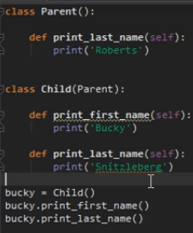

Example
In this example, Parent is the super class and Child is the subclass.
The parent class has a method called “print_last_name” which returns Roberts as their last name.
Child inherits this method and returns Snitzleberg as their last name. Also has a “print_first_name” method which returns their first name “Bucky”.
When the child function is run, it returns Snitzleberg rather than Roberts as it has been overridden.

Slide 7
Delegation

Slide 8
What is Delegation
Handling a request by passing it on to another sub handler
This sub handler can then either do all of the work requested by the parent or pass it to it’s sub handler depending on the use case
Increases code reusability as multiple parent handlers can use the same sub handlers if the use case is there
Decreases duplication
Decreases code length in larger software applications where duplication is high

Slide 9
Disadvantages of Delegation
Increases code length in small programs
Increases code complexity

Slide 10
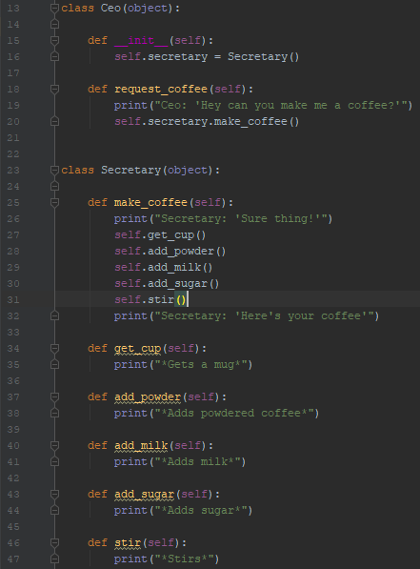
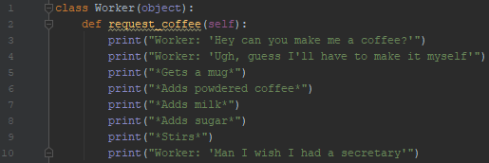
Example
Without delegation
With delegation

